Slide 1
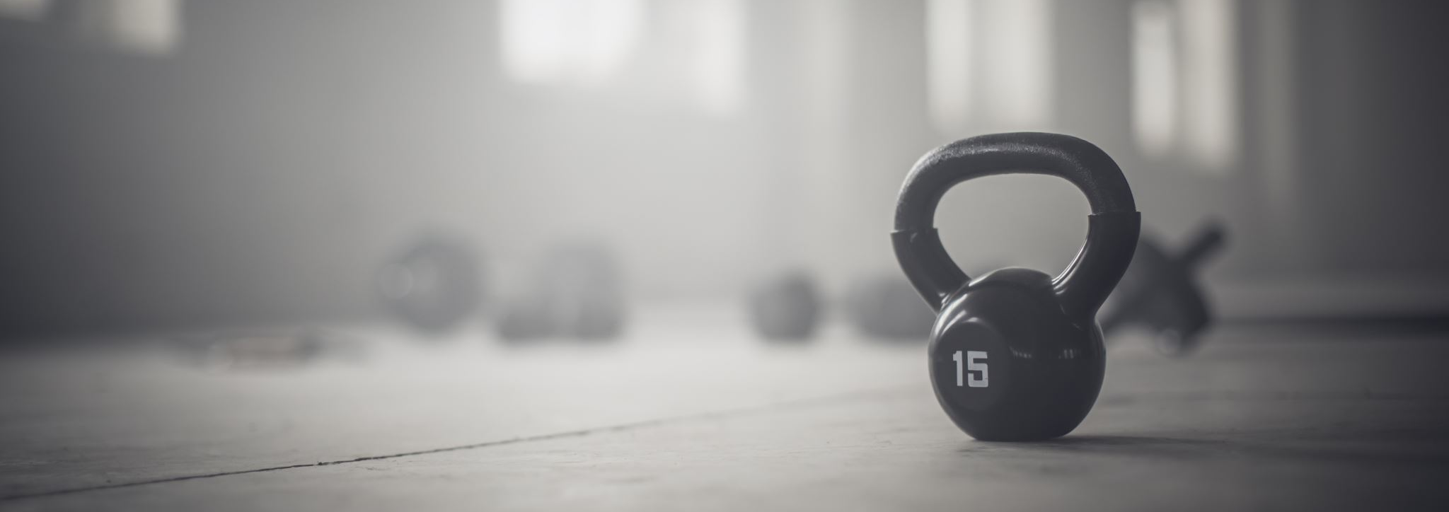
Fitness Buddy
Using Pattern recognition to guess the best form of exercise
Dataset.
Pre-Processing.
Packages used.
Comparing Accuracies and testing with a data frame.
Data Representation.
Example.
Confusion Matrix.
Code.

Slide 2
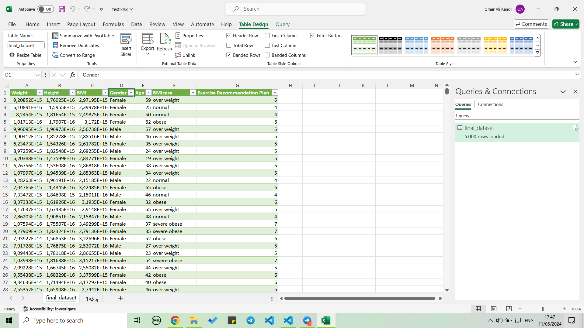
Dataset
The dataset contains 5000 rows of data
Has 6 Features(Weight, Height , BMI, Age, BMIcase).
Our target is: Exercise Recommendation Plan. (7 plans)

Slide 3
Pre-Processing
We encountered Data that are in form of a string , which our knn algorithm can’t deal with
We decided to change all the data to numerical form with number representations.
For gender: female=0,male=0
For BMIcase: Overweight: 4, Normal: 1, Obese: 5, Severely Obese: 6, Mild Thinness: 2, Severely Thinness: 3, Moderate Thinness: 4

Slide 4
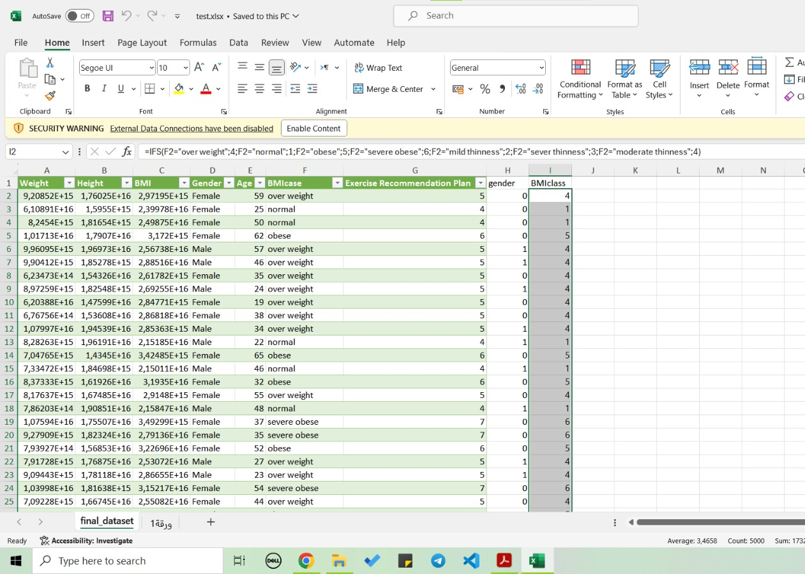
Data comparision
We decided on adding columns to maintain the integrity of data.
We decided to drop the unneeded columns inside the code.

Slide 5
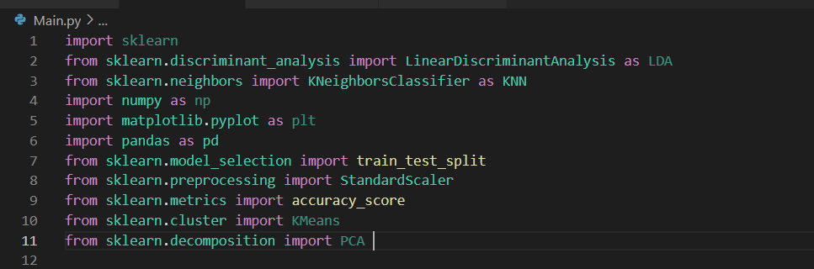
Packages.
Python has many packages that support the algorithms we need.
Mainly the sklearn Package

Slide 6
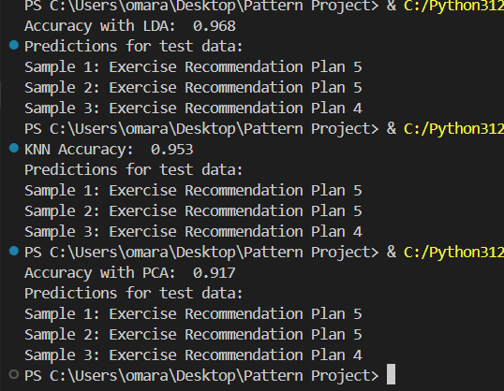
Comparing Accuracies

Slide 7
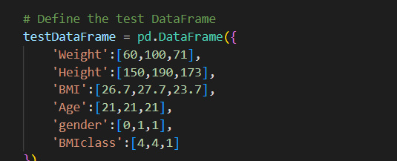
Here are Example plans for people with similar values as in the sample

Slide 8
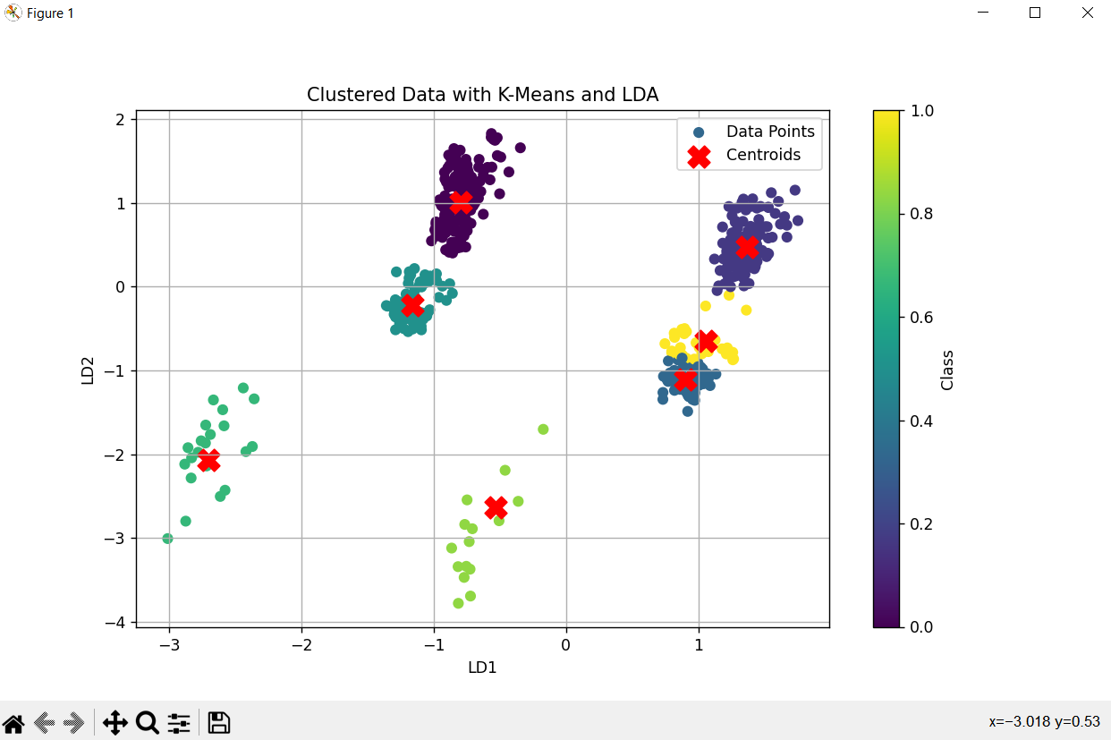
Data representation.
With the help of K-means clustering Algorithm.

Slide 9
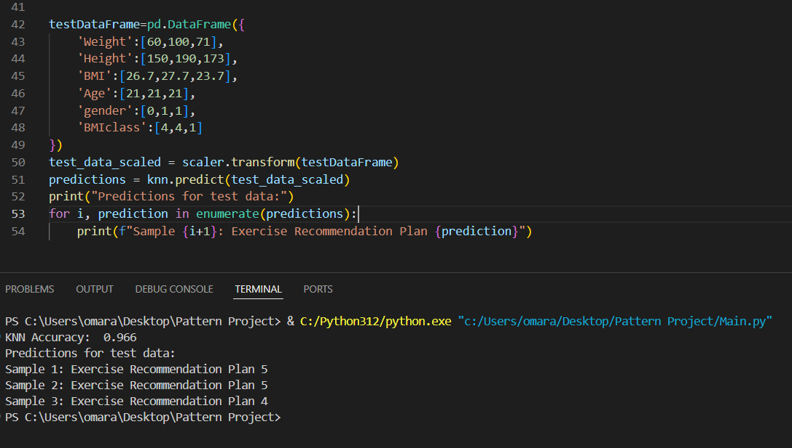
Example

Slide 10
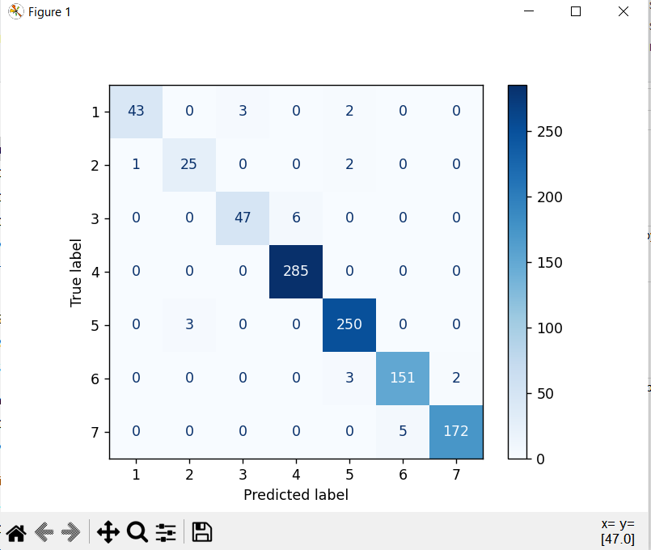
Confusion Matrix.
As seen in the confusion matrix, the main diagonal represents the number of times the model got classifications correctly.
Clearly represents our accuracy in K-NN

Slide 11
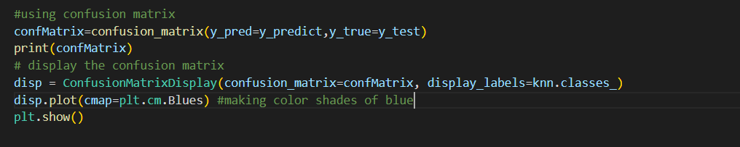
Confusion Matrix Code.

Slide 12
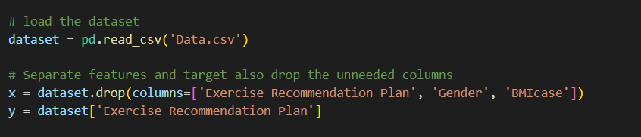
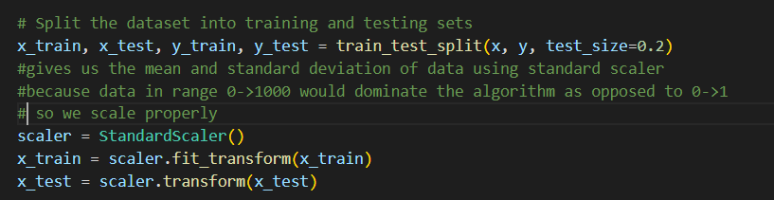
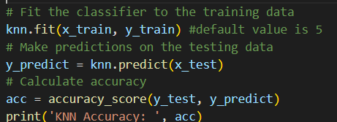
Code
Decided on using pandas library to deal with the dataset

Slide 13
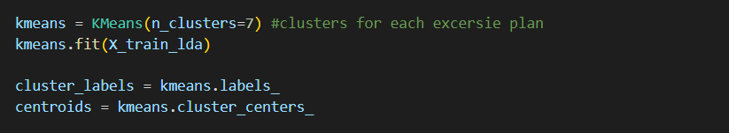

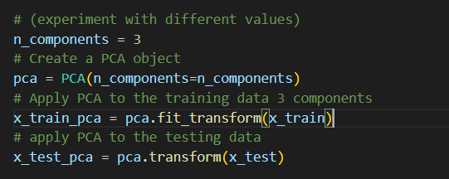
Code

